Slide 1

INTELLERA: A Hardware Based Accelerated Matrix MAC Processor
Team Members:
2020414 Saad Khan
2020487 Syed Zaeem Shakir
2020217 Mahnoor Maleeka
Supervisor: Dr Fahad Bin Muslim
Co-supervisor: Dr Taj Muhammad
Faculty of Computer Sciences and Engineering Ghulam Ishaq Khan Institute of Engineering Sciences and Technology, Pakistan
Notes:
1

Slide 2
Evaluation Criteria
PLO 3 | Design/Development of Solutions
PLO 4 | Investigation
Rubrics | PLO3 | PLO4 | - | Marks
Requirements Gathering Methodology |  | ✓ |  | 5
Requirements Specifications |  | ✓ |  | 10
Proposed Design | ✓ |  |  | 10
Requirements were mapped to the design adequately | ✓ |  |  | 5
Division of Tasks / Use of Project Management Tools | - | - | ✓ | 10

Slide 3
Recap
Motivation:
Faster
Greener
Game-Changer
Benefits:
Speed
Efficiency
Breakthroughs
Significance:
Innovation
High-Performance Computing
Conclusion:
Matrix MAC FPGA Acceleration

Slide 4
Introduction / Problem Statement
Introduction: RISC-V FPGA Matrix MAC
Problem: Speeding Up Matrix Operations
Challenge: Efficiency & Performance
Objective: Innovative FPGA Solution

Slide 5

REQUIRMENTS GATHERING METHODOLOGY
RUBRIC # 1

Slide 6
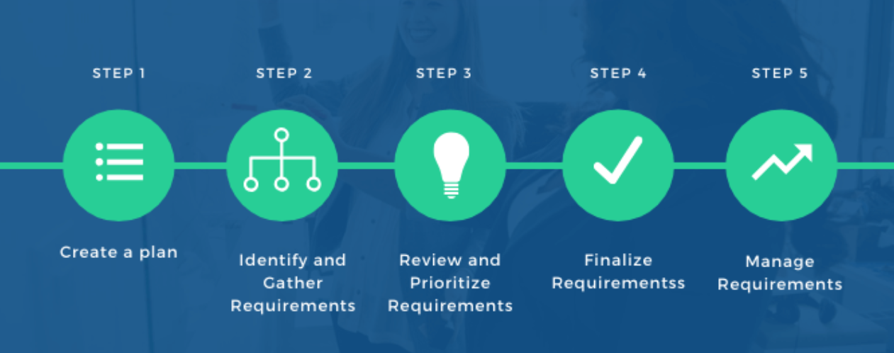
Requirements Gathering Methodology
RUBRIC 1 : Requirement Gathering Methodology

Slide 7
Requirements Elicitation Technique(s) Followed
RUBRIC 1 : Requirement Gathering Methodology
Literature Review: Studied past research papers.
Benchmarking Data: Studied past work.
Consultations: Consulted Different professors working in the same field
Brainstorming: Detailed discussions on our project.
Notes:
Elaborate with example(s) from your project

Slide 8
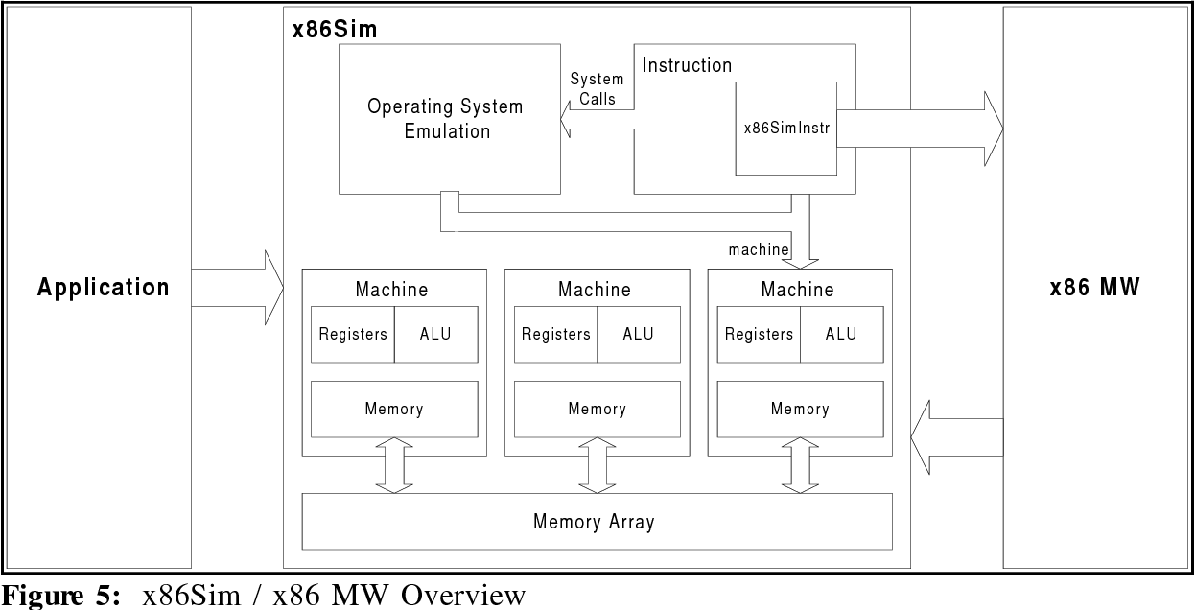
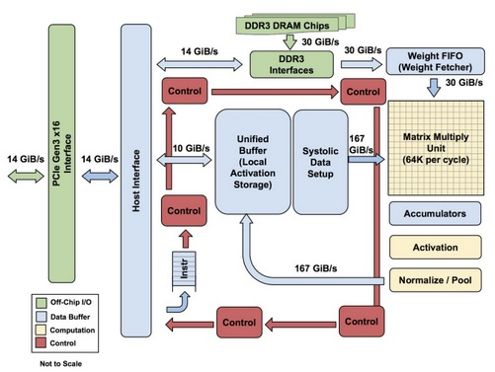
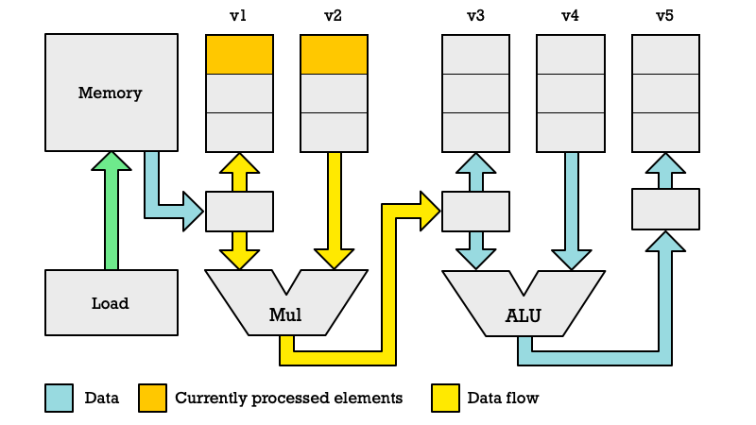
RUBRIC 1 : Requirement Gathering Methodology
ARM X86 Architecture
TPU Architecture
RISC-V Vector Extension Architecture
3
Previous
Designs
2
1
https://ieeexplore.ieee.org/document/9774501/
https://ieeexplore.ieee.org/document/8358031
https://ieeexplore.ieee.org/document/9988933/

Slide 9
RUBRIC 1 : Requirement Gathering Methodology
ARM X86 Architecture
TPU Architecture
RISC-V Vector Extension Architecture
3
Previous
Designs
2
1
https://ieeexplore.ieee.org/document/9774501/
https://ieeexplore.ieee.org/document/8358031
https://ieeexplore.ieee.org/document/9988933/

Slide 10
RUBRIC 1 : Requirement Gathering Methodology
ARM X86 Architecture
RISC-V Vector Extension Architecture
TPU Architecture
3
Previous
Designs
2
1
https://ieeexplore.ieee.org/document/9774501/
https://ieeexplore.ieee.org/document/8358031
https://ieeexplore.ieee.org/document/9988933/

Slide 11
RUBRIC 1 : Requirement Gathering Methodology
ARM X86 Architecture
TPU Architecture
RISC-V Vector Extension Architecture
3
Previous
Designs
2
1
https://ieeexplore.ieee.org/document/9774501/
https://ieeexplore.ieee.org/document/8358031
https://ieeexplore.ieee.org/document/9988933/

Slide 12
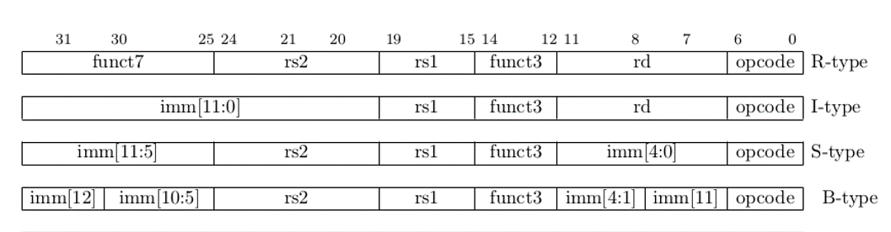
RUBRIC 1 : Requirement Gathering Methodology
Type of Instructions

Slide 13
R type instruction
Source Register 2
Source Register 1
Destination Register
Bits placement:
| 31 25 | 24 20 | 19 15 | 14 12 | 11 7 | 6 0 |
Bits Division:
funct7
rs2
rs1
funct3
rd
opcode
Bits Size:
7-bits
5-bits
5-bits
3-bits
5-bits
7-bits
Demo Instruction: add x1, x2, x3
Opcode: 0110011
F3 Value: 000
F7 Value: 0000000
X1 Address: 00001
X2 Address: 00010
X3 Address: 00011
funct7
rs2
rs1
funct3
rd
opcode
funct7
X3
X2
funct3
X1
opcode
0000000
X3
X2
000
X1
0110011
0000000
00011
00010
000
00001
0110011

Slide 14
Project - Assumptions & Constraints
RUBRIC 1 : Requirement Gathering Methodology
Assumptions: Clear ISA Understanding
Constraints: FPGA Resource Limitations
Guiding: Design and Implementation

Slide 15
Requirements Specifications
Rubric # 2

Slide 16
RUBRIC 2 : Requirement Specification
FUNCTIONAL REQUIREMENTS
Custom ISA
Matrix MAC Instructions
Pipelining
Compatibility
FPGA Implementations

Slide 17
RUBRIC 2 : Requirement Specification
NON-FUNCTIONAL REQUIREMENTS
Power Efficiency
Performance
Scalability
Testing & Verification

Slide 18
Feature Set Matrix
RUBRIC 2 : Requirement Specification
Feature / Use Case | Priority of Development | Dependencies
Load Data | High | None
Perform any Operation | High | Load Data
Store Result | High | Perform Matrix Operation
Implement FPGA | Medium | None
Optimize Matrix MAC Code | Medium | Perform Matrix Operation
Error Handling | Medium | All Features
Performance Optimization | Low | Optimize Matrix MAC Code

Slide 19

Any other external requirements
RUBRIC 2 : Requirement Specification
Regulatory Compliance
Customer/Stakeholder Expectations
Resource Constraints
Environmental Factors
Supplier Dependencies
Intellectual Property
Safety & Compliance
Ethical & Social Considerations
Documentation & Reporting

Slide 20
UML Diagram’s
Notes:
Only need to create a component diagram In this

Slide 21
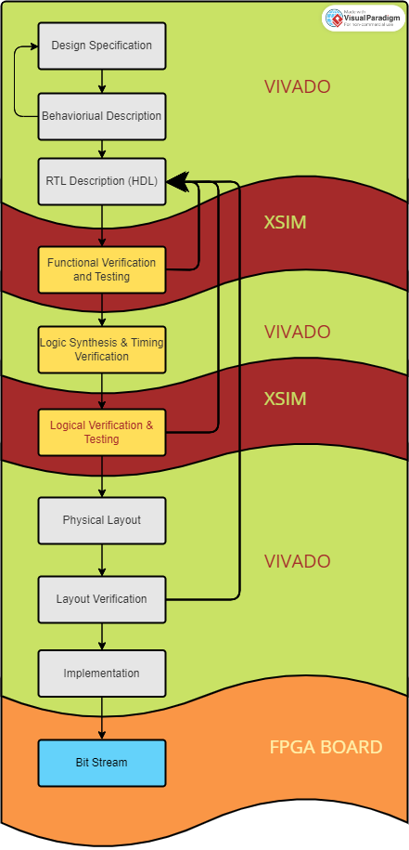
Context Diagram / High Level Block Diagram
RUBRIC 2 : Requirement Specification

Slide 22
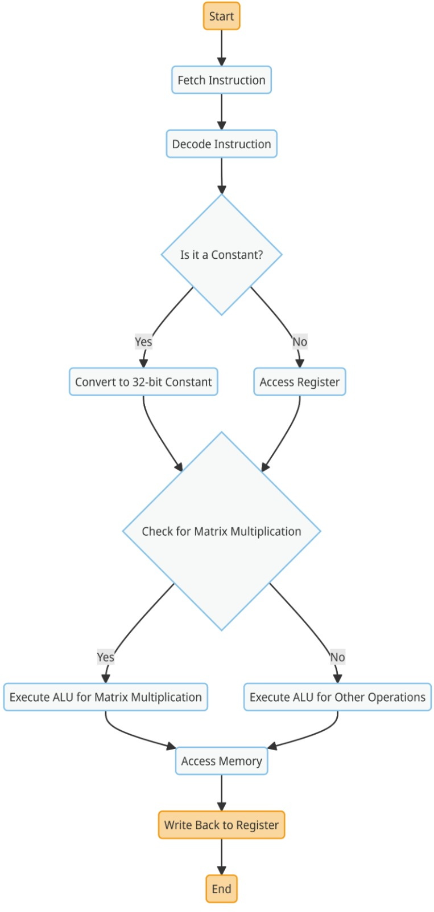
STATE/ACTIVITY DIAGRAM
RUBRIC 2 : Requirement Specification

Slide 23

Project Design
RUBRIC # 3

Slide 24



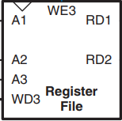
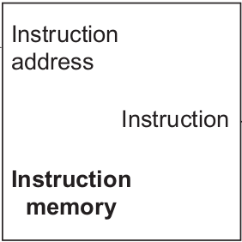

Animation of a Single Cycle Processor
RUBRIC 3: Proposed Design

Slide 25
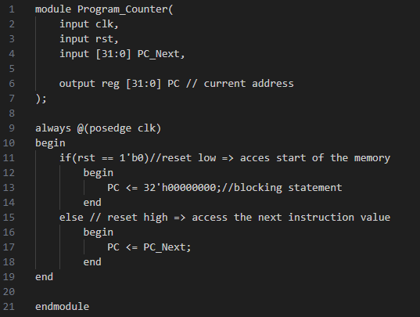
Program Counter
RUBRIC 3: Proposed Design

Slide 26
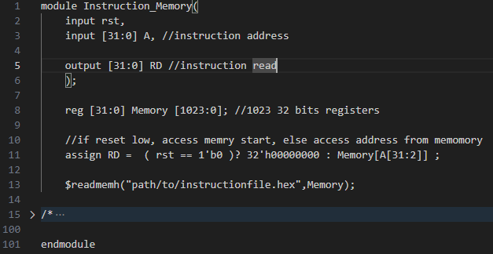
Instruction Memory
RUBRIC 3: Proposed Design

Slide 27
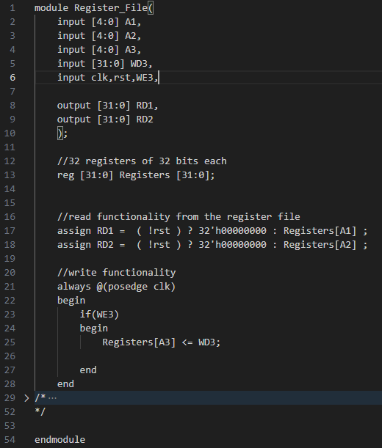
Register File
RUBRIC 3: Proposed Design
RUBRIC 3: Proposed Design

Slide 28
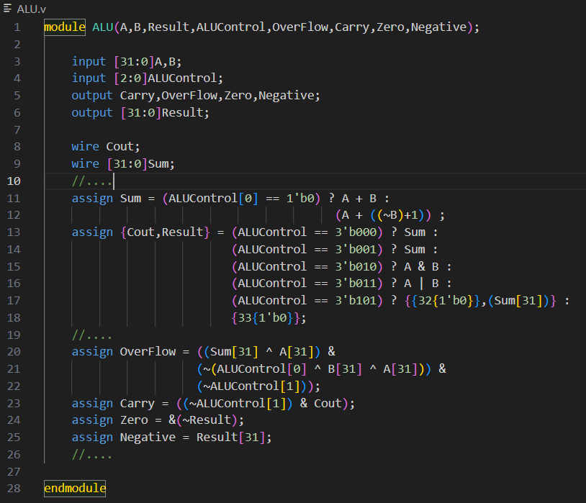
ALU
RUBRIC 3: Proposed Design

Slide 29
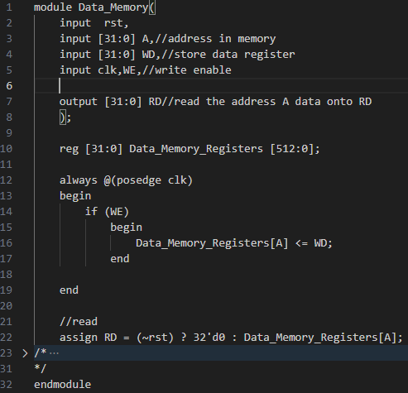
Data Memory
RUBRIC 3: Proposed Design

Slide 30
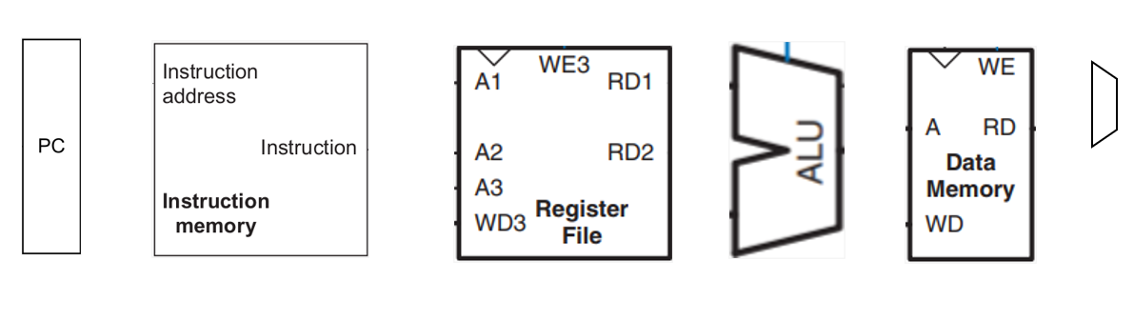

RUBRIC 3: Proposed Design
Animation of a Single Cycle Processor
5
0x4
X2
2
5
003100B3
X3
3
5
X1
5
Test Case:
PC Hex-Code Assembly
5 = 2 + 3

Slide 31
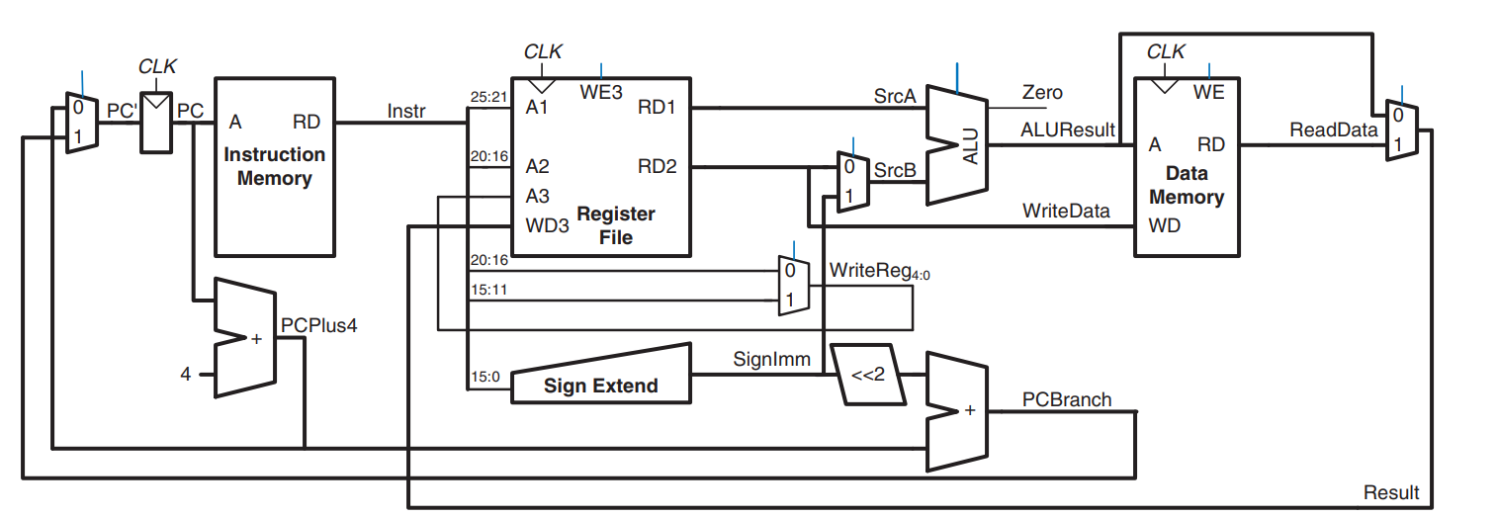
RUBRIC 3: Proposed Design
A Complete Single Cycle Processor
A Pipelined Processor
Fetch
Decode
Execute
Memory
Writeback
Hazard Unit
Proposed Design

Slide 32

Proposed Design
RUBRIC 3: Proposed Design
A Complete Single Cycle Processor
A Complete Matrix MAC Processor
A Pipelined Processor
INPUT
OUTPUT
Fetch
Decode
Execute
Memory
Writeback
Matrix
MAC
Hazard Unit

Slide 33
MATRIX MAC
INPUT
OUTPUT
Fetch
Decode
Execute
Memory
Writeback
Hazard Unit

Slide 34
Requirements mapped Adequately to the Design
RUBRIC # 4

Slide 35
Division of Tasks & Project Management
RUBRIC # 5

Slide 36
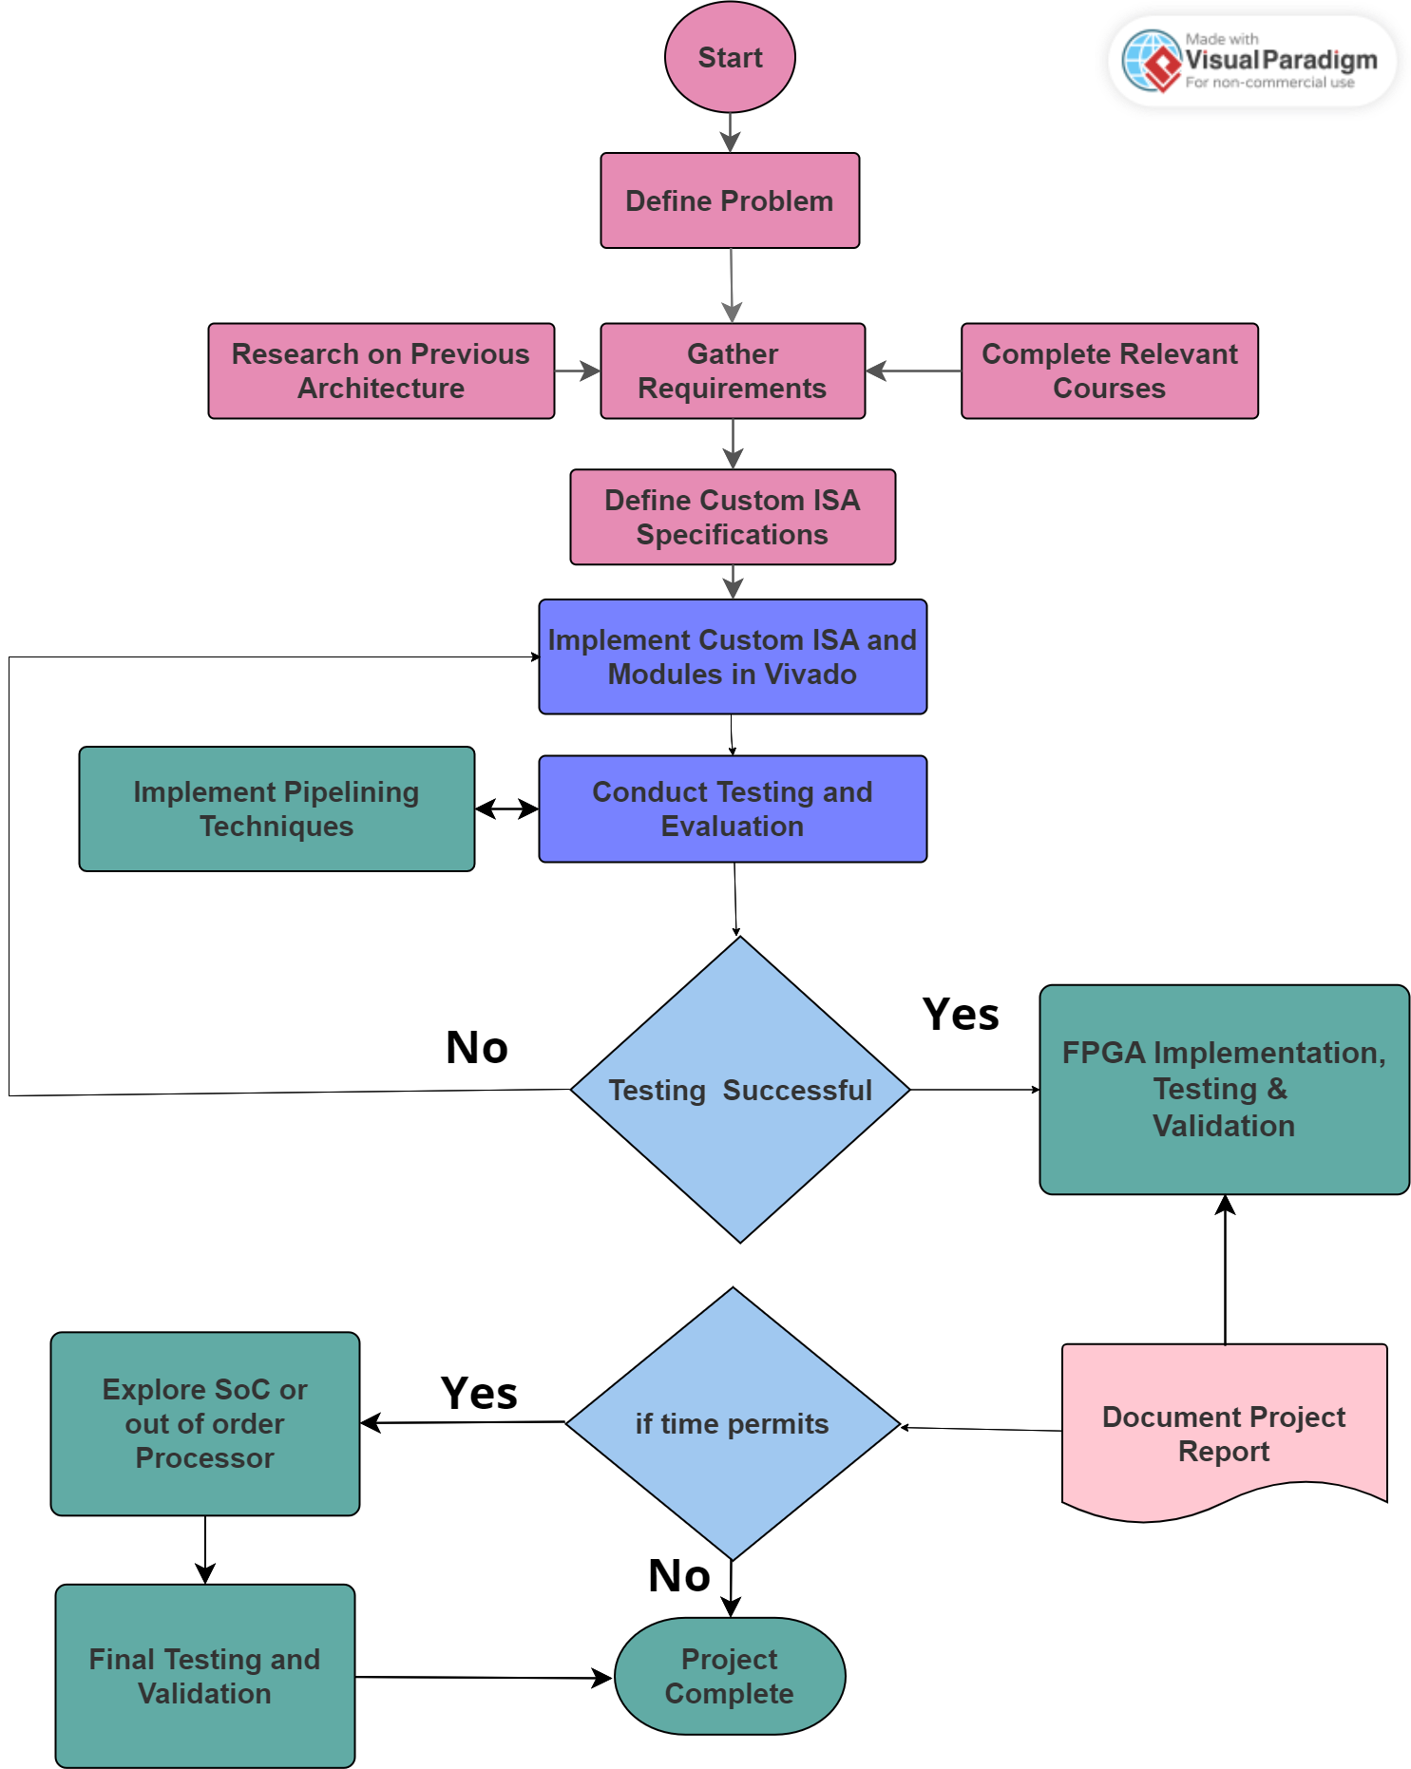
Workflow Chart
RUBRIC 5: Tasks Division & Project Management

Slide 37
Division of Tasks
RUBRIC 5: Tasks Division & Project Management
Assigned Responsibilities
Team Members:
Saad Khan – Team Lead
Mahnoor Maleeka
Zaeem Shakir
Saad Khan:
RISC-V Processor Architecture
Pipeline Implementation
Matrix MAC Instruction Module
Hazard’s Solution
Project Management (Jira and GitHub)
Mahnoor Maleeka:
RISC-V Processor Architecture
Pipeline Design
FPGA Implementation
Testing and Verification
Documentation
Zaeem Shakir:
RISC-V Processor Architecture
Matrix MAC Instruction Module
FPGA Implementation
Performance Optimization
GitHub Management

Slide 38
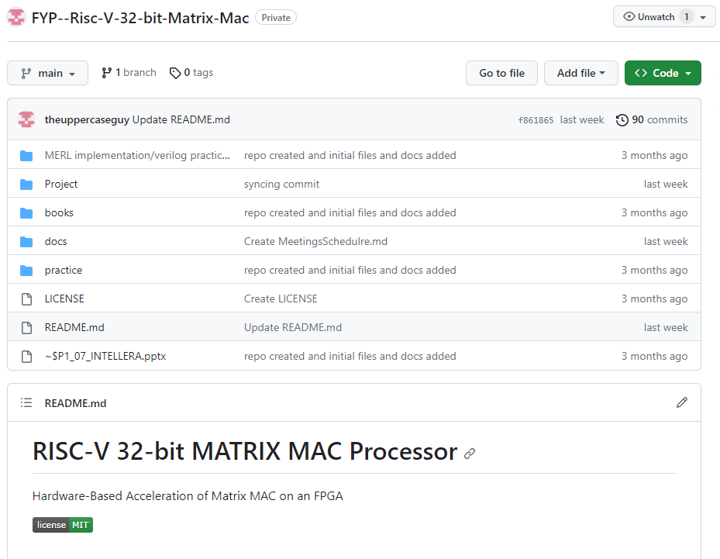
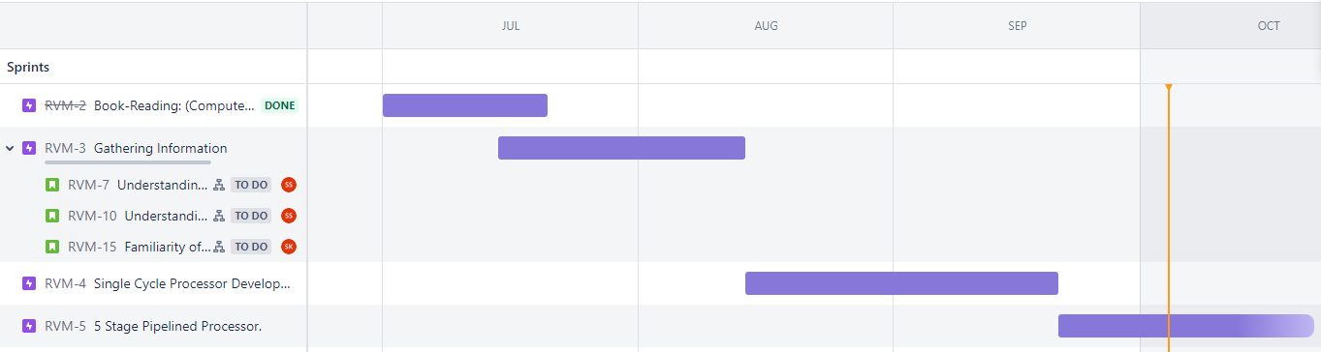
Project Repository Tool: GITHUB
RUBRIC 5: Tasks Division & Project Management
Project Management Tool: JIRA

Slide 39

Thank You

